Slide 1

Hospitalizations Rates & Trends
By Ndinda Kasyoka

Slide 2
Table of Contents
01
02
03
04
Questions of Interest
Data Description
Stay-at-Home Analysis
Conclusion

Slide 3


Questions of Interest
How have stay at home policies been issued per US state and what are their levels of strictness?
How did the stringency of stay-at-home policies correlate with hospitalization and death rates across different states?
What role did demographic factors (e.g., age, population density) play in the implementation and effectiveness of stay-at-home policies?

Slide 4

02
Data Description

Slide 5

Data Set
Stay at Home Orders
Range of policies
1 being the strictest and 7 the least strict
1 - Mandatory for all individuals
2 - Mandatory only for all individuals in certain areas of the jurisdiction
3 - Mandatory for at risk individuals in the jurisdiction
5 - Mandatory only for at risk areas in certain areas of the jurisdiction
6 - Advisory/ Recommended
7 - No order for individuals to stay home
Contains stay at home policies issued to states every other day either officially (press conferences) or unofficially (media)
51 States including DC
March 2020 - February 2021
Stay at home policies range from 1 to 7 (excluding 4)

Slide 6
03
Stay-at-Home Analysis

Slide 7
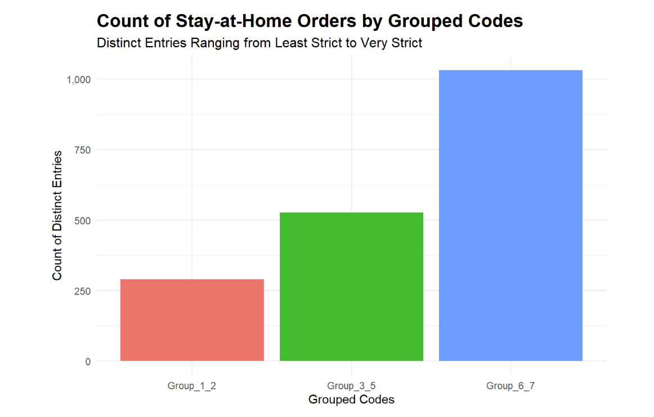
Overall, the strictest policies were the least issued followed by the moderate policies then finally the least strict policies were the most recorded over time
This shows that either more states did not have as strict policies or some did at the beginning of some days and stopped issuing the orders after some time
What states had the most strict, least strict and the moderately strict laws?

Slide 8
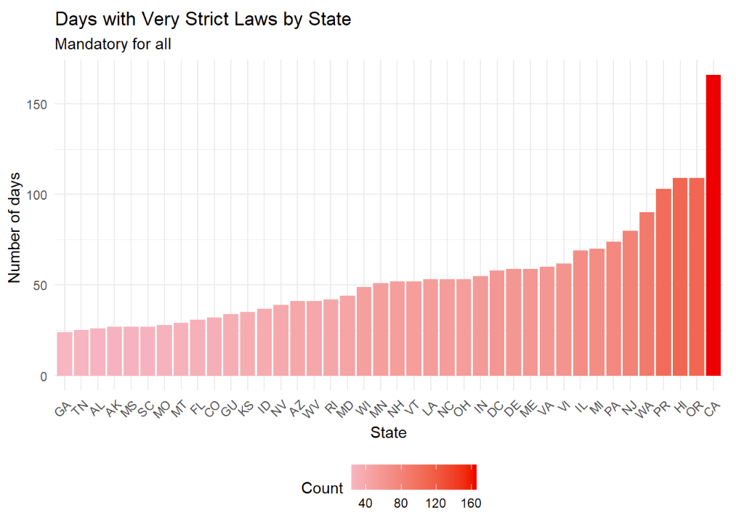
Most Strict Policies
We plotted a graph that shows all the states with mandatory policies that is code 1 and 2 and we found that California had the highest number of entries per day.

Slide 9
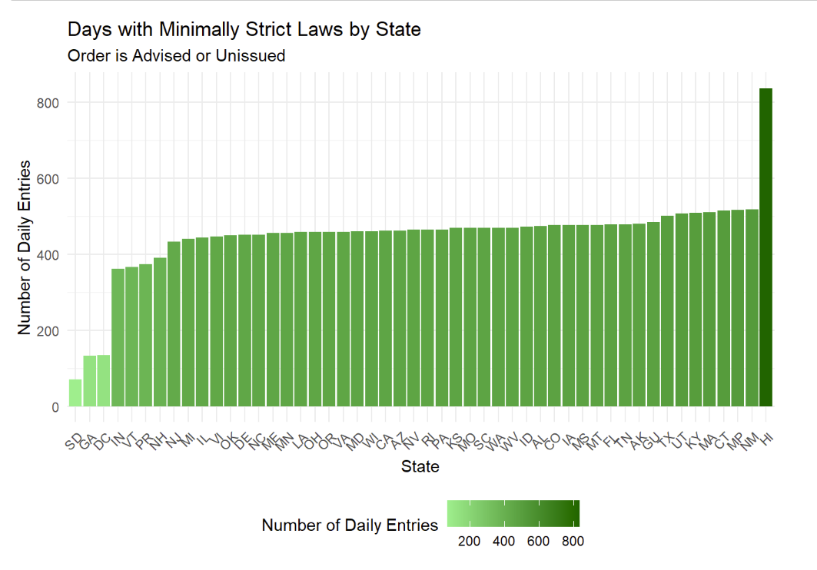
Least Strict Policies
The graph on the left shows states that had the least strict policies where state governments recommended that citizens should stay at home or there was no issuing of orders by the government.
Hawaii had the highest number of entries showing that they did not have strict stay at home orders over time

Slide 10
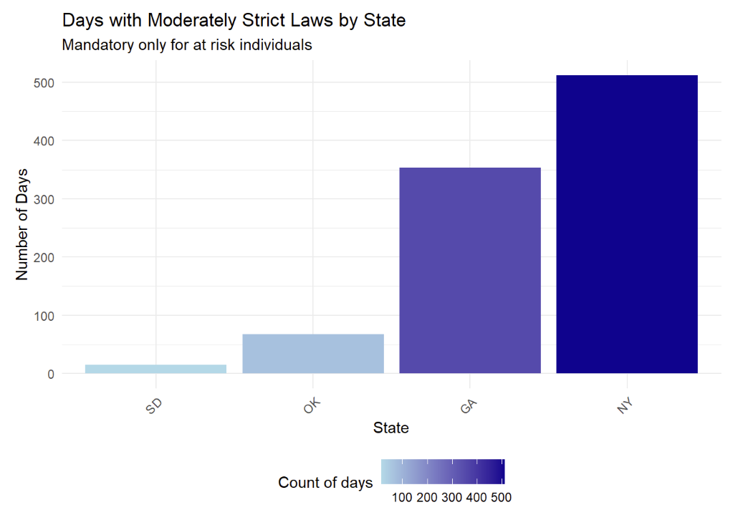
Moderately Strict Policies
The graph on the left shoes states that had the moderate policies that were only mandatory for at risk individuals
Fewer states have these moderately strict laws and some of them like South Dakota tend more towards the less strict policies

Slide 11
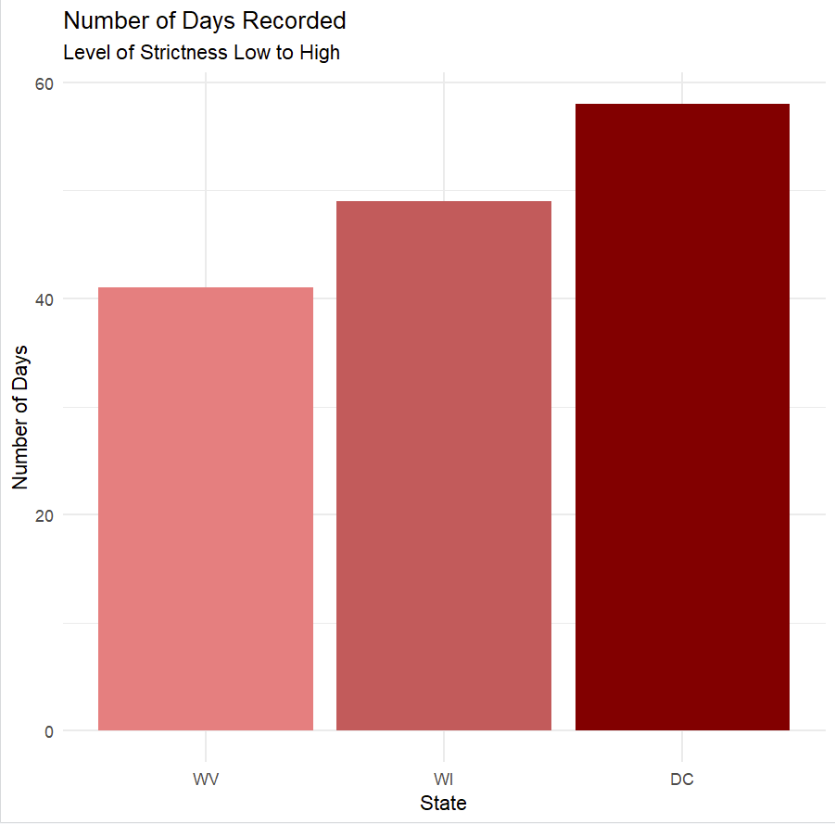
Comparison Among States Politically
We now compared the some states within the category with the most strict policies across political lines assuming these could impact policy making.
West Virginia was the most republican state in the distribution , Wisconsin a swing state and finally DC which is under Washington the bluest state.
The graph supported our assumptions that the more red states would have less mandatory policies issued compared to the more blue states

Slide 12
06
Conclusion

Slide 13
Conclusion and Recommendations:
Our analysis reveals a significant correlation between the political landscape of a state and the stringency of its stay-at-home policies.
States with more liberal political orientations tended to implement stricter stay-at-home orders, while more conservative states were less stringent. This political influence on public health policies underscores the complexity of managing a pandemic response in a politically diverse country.
We can draw various conclusions from our analysis such as;
Policy Development: Organizations should consider the political context when developing public health strategies. Tailoring communication and policy recommendations to align with the political climate of different regions can enhance compliance and effectiveness.
Data-Driven Decision Making: Utilize demographic and epidemiological data to refine stay-at-home policies. States should adopt a flexible approach that considers both the political environment and specific demographic factors to optimize public health outcomes.
Public Awareness Campaigns: Increase efforts in public awareness and education campaigns, especially in regions with less stringent policies. Highlighting the effectiveness of strict measures in controlling hospitalization and death rates can foster better public cooperation.

Slide 14
Sources
Stay-at-Home Orders (CDC)
https://data.cdc.gov/Policy-Surveillance/U-S-State-and-Territorial-Stay-At-Home-Orders-Marc/y2iy-8irm/about_data

